Slide 1
ENGLISH CLUB
Welcome to our English club

Slide 2
PROGRAMMES
I. GETTING TO KNOW EACH OTHER
II. WHO IS FASTER ?
III. CROSSWORD PUZZLE
2022
20-11
IV. GUESSING PICTURES
V. FOR AUDIENCE

Slide 3
Let's start

Slide 4
PART I
EACH OF TEAM HAS 5 MINUTES TO INTRODUCE YOURSELVES
Getting to know each other

Slide 5
Part 2
Who is faster

Slide 6
In this game, you will see the flags of some countries in the world and talk about what the country is , who gives the faster answer they will win and give 10 marks for each question.

Slide 7
England

Slide 8
China

Slide 9
America

Slide 10
Malaysia

Slide 11
Korea

Slide 12
Singapore

Slide 13
Thailand

Slide 14
Lao

Slide 15
Australia

Slide 16
Canada

Slide 17
Part 3
Crossword puzzle

Slide 18
Crossword puzzle
1
V
I
E
T
N
A
M
2
C
H
I
N
A
3
S
I
N
G
A
P
O
R
E
4
L
A
O
5
T
H
A
I
L
A
N
D
6
I
N
D
I
A
7
C
A
N
A
D
A

Slide 19
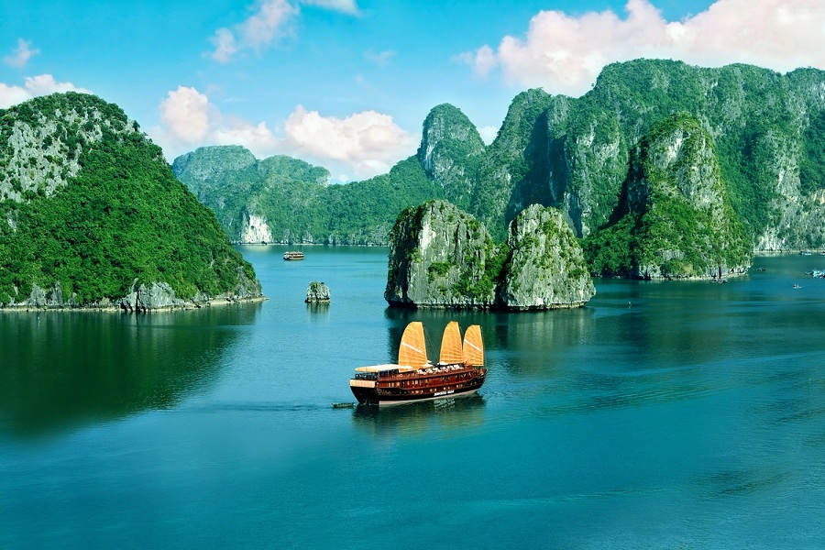

Slide 20
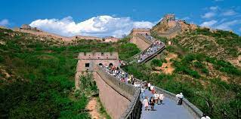

Slide 21
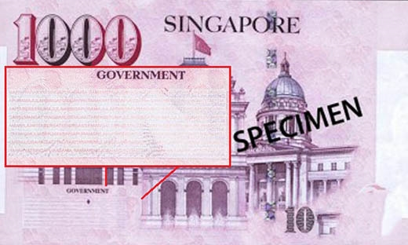

Slide 22
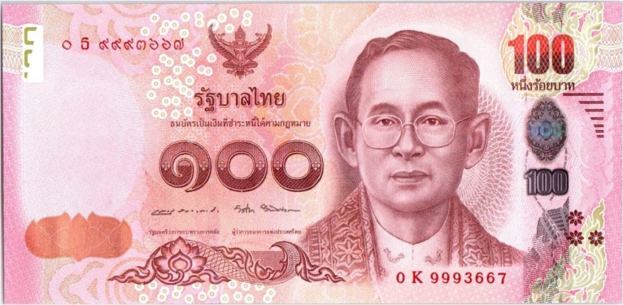

Slide 24
Thủ đô của nước này là thành phố Ottawa,

Slide 25
2. Là một quốc gia không giáp biển duy nhất tại vùng Đông Nam Á.
3. Phía Tây Băc giáp biên giới nước Myanma và Trung Quốc Phía đông giáp Việt Nam ,Phía Nam giáp Campuchia và phía tây giáp Thái Lan .

Slide 26
Part 4
Guessing pictures

Slide 27
In this game, all of you use small boards and write the name of the capital and its country on it , teacher will give 10 marks for each student in a team if you give the correct answer.

Slide 28
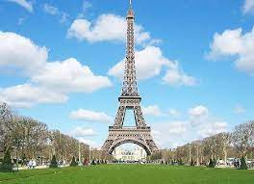
Paris -France

Slide 29
Bac Kinh- China

Slide 30
Bang Kok- Thailand

Slide 31
Phnom penh- Compuchia

Slide 32
Washing Ton- America

Slide 33
Seoul- Korea

Slide 34
Ha Noi- Viet Nam

Slide 35
Singapore- Singapore

Slide 36
For
Audience

Slide 37
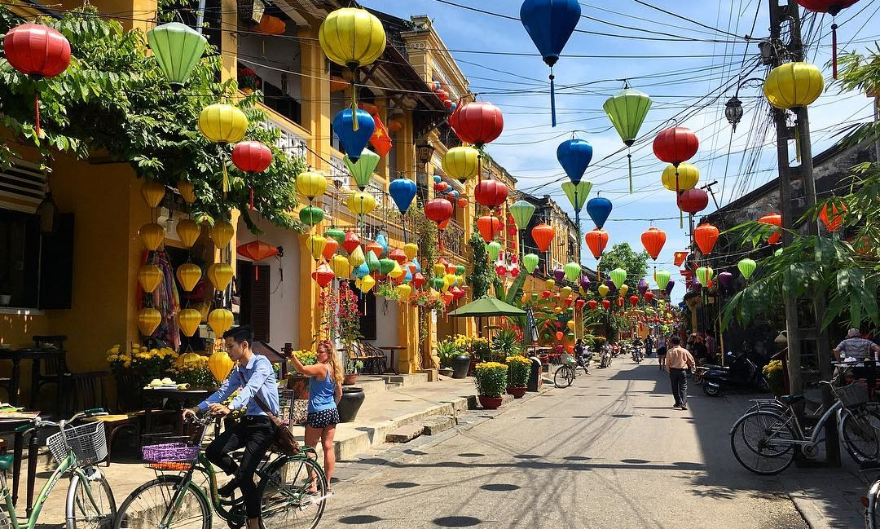
Hoi an ancient town –Viet Nam

Slide 38
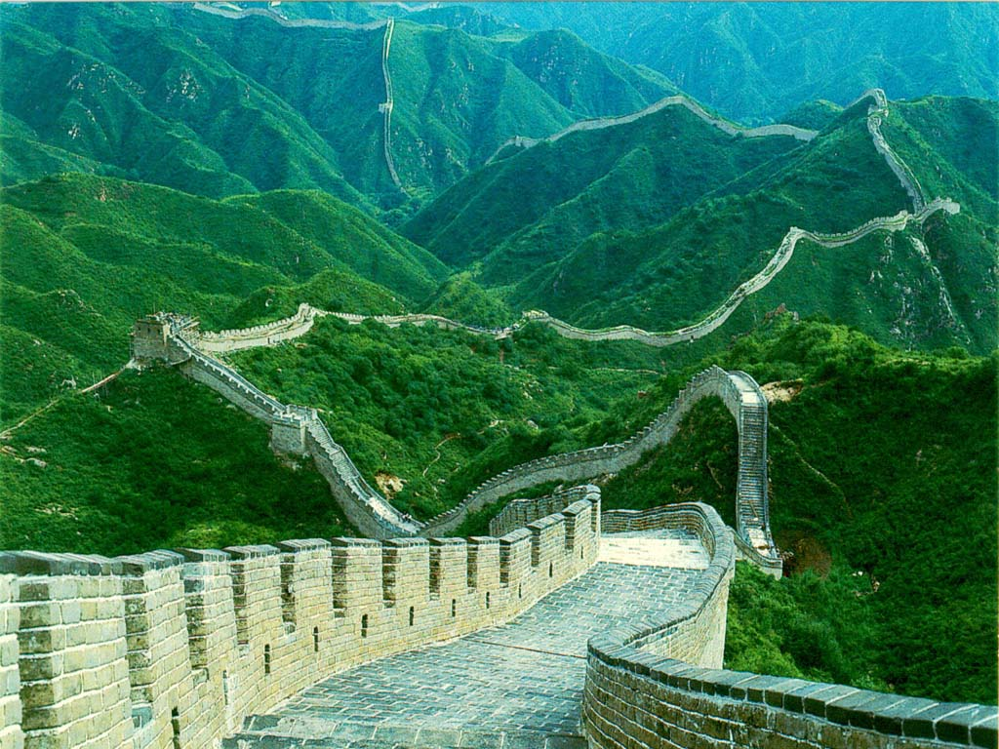
THE GREAT WALL OF CHINA

Slide 39
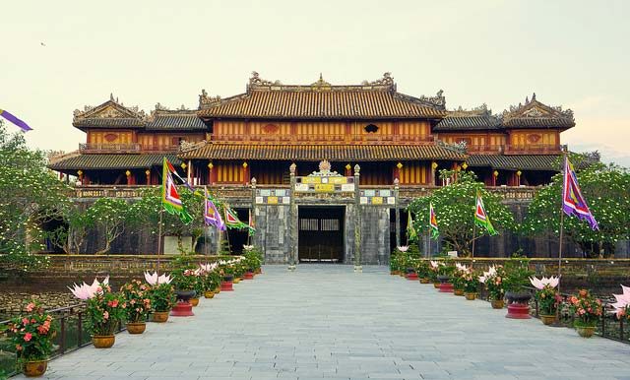
Hue Citadel

Slide 40
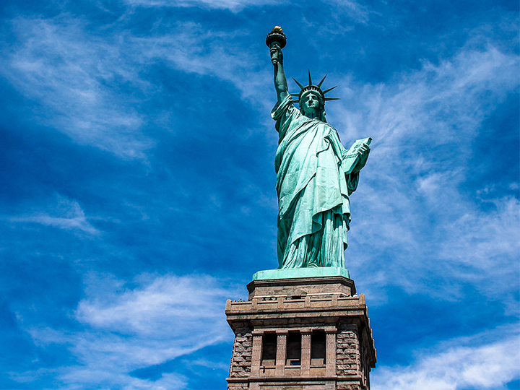
The staue of liberty

Slide 41
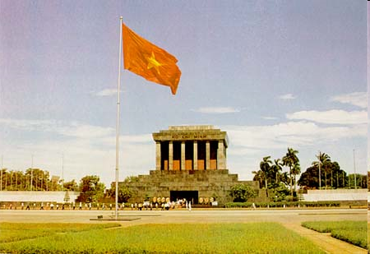
HO CHI MINH MAUSOLEUM

